Slide 1

The Effects of Covid-19 on Various Life Factors in Students
Eric Schneider

Slide 2
Introduction
During the Covid-19 Pandemic, many students were forced into Distance (virtual) Learning models in order to prevent further spread of the disease.
During this time, many of them were unable to properly socialize and may not have spent enough time outside of their homes in general.
This lead to a significant increase in school-related stress as well as strains on family relationships
Objective: To analyze the impact of various life factors and identify various interventions to recommend to schools.

Slide 3
Problem Statement and Objectives
The Covid-19 pandemic has disrupted education, affecting students' academic performance and well-being. Schools need data-driven insights to understand these impacts and identify effective interventions. Our study aims to analyze the effects of the pandemic on student life factors and recommend strategies, such as nutrition programs and counseling services, to support student recovery and improvement.
Objectives:
Understand the impact of Covid-19 on students.
Identify effective interventions.
Provide data-driven recommendations.

Slide 4
Data Collection and Description
Data Source: Our data was collected from educational institutions and surveys during the Covid-19 pandemic.
Key Variables:
Performance Measures:
T0, T1, T2: Academic scores at different time points.
N, N.1, N.2: Number of students at different time points.
Measure.1, Measure.2: Specific academic performance measures.
SD, SD.1, SD.2: Standard deviations of scores at different time points.
Author | Group | T0 | Scale | Measure | SD | N | T1 | Scale | Measure | SD | N | T2 | Scale | Measure | SD | N
Cataldi | Control-Y |  | BMI | 22.48 | 2.2 | 15 | Immediately | BMI | 22.45 | 2.12 | 15
 |  |  | Waist circumference (cm) | 74.87 | 7.59 |  |  | Waist circumference (cm) | 74.9 | 7.53
 |  |  | Squat test (rep) | 28.89 | 2.4 |  |  | Squat test (rep) | 29.4 | 2.56
 |  |  | Push-up test (rep) | 9.13 | 4.2 |  |  | Push-up test (rep) | 9.53 | 4.34
 |  |  | Lunge test (rep) | 31.13 | 5.4 |  |  | Lunge test (rep) | 31.4 | 6.07

Slide 5
Data Collection and Description Ctd.
Interventions:
Scale, Scale.1, Scale.2: Types of assessment scales used.
Group: Different intervention groups (e.g., counseling, after-school programs).
Author: Identifiers for data sources.
Size of the Dataset:
Records for 3 groups, 15 variables.

Slide 6
Data Collection and Description Ctd.
Relevance to the Study:
Captures the impact of Covid-19 on student performance and the effectiveness of interventions.
Informs evidence-based recommendations for educational support.

Slide 7
Data Wrangling
Handling Missing Values:
Imputed missing numerical values (e.g., T0, T1 scores) with the mean.
Filled missing categorical values (e.g., Scale, Group) with the most frequent value.
Standardizing Numerical Data:
Applied standard scaling to numeric features (e.g., T0, T1, N).
Encoding Categorical Data:
Used one-hot encoding for categorical features (e.g., Scale, Group).

Slide 8
Data Wrangling Ctd.
Importance:
Ensures dataset completeness and accuracy.
Normalizes feature range for better model performance.
Converts categorical variables for machine learning use.

Slide 9
Data Wrangling Ctd.
Importance:
Ensures dataset completeness and accuracy.
Normalizes feature range for better model performance.
Converts categorical variables for machine learning use.

Slide 10
Exploratory Data Analysis (EDA)
Trends and Patterns:
Performance Measures: Improvement in academic scores (T0, T1, T2) over time for some groups.
Interventions: Certain groups (G1, G2) showed higher improvements with specific interventions (e.g., Scale1).
**Visualizations
Insights:
Interventions are correlated with improvements in academic performance.
Group-specific interventions yield different outcomes, suggesting the need for tailored approaches.

Slide 11
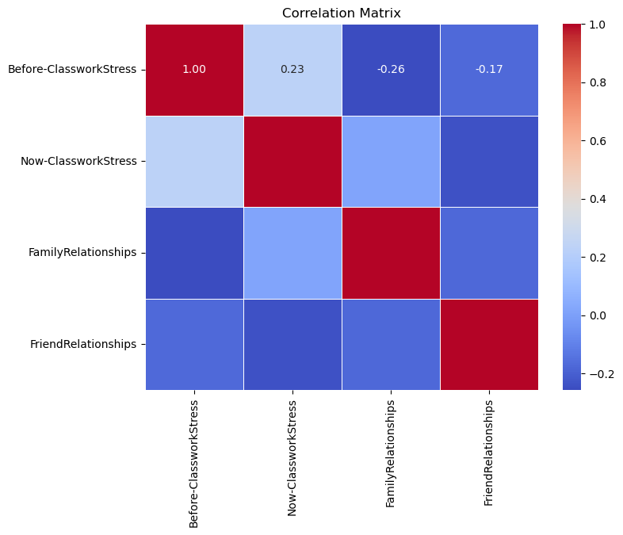
EDA Ctd.

Slide 12
Feature Engineering/Preprocessing(FEP)
Dummy Feature Creation:
Converted categorical variables (e.g., Scale, Group) into dummy/indicator variables to make them suitable for modeling.
Scaling and Standardization:
Standardized numerical features (e.g., T0, T1, T2) to ensure all features contribute equally to the model.
Applied ‘StandardScaler’ to numerical data to achieve zero mean and unit variance

Slide 13
FEP Ctd.
1. Data Split:
- Features (X) and Target (y)
2. Numerical Features:
- Impute Missing Values (Mean)
- Standardize (StandardScaler)
3. Categorical Features:
- Impute Missing Values (Mode)
- Encode (OneHotEncoder)
4. Combine Preprocessed Features for Modeling

Slide 14
DEP Ctd.
Preprocessing Pipeline
Imputation:
Used ‘SimpleImputer’ to fill missing numerical values with the mean and categorical values with the most frequent category
Scaling:
Applied ‘StandardScaler’ within the pipeline to standardize numerical features
Encoding:
Utilized ‘OneHotEncoder’ to handle categorical data, ensuring no loss of information

Slide 15
Model Building/Evaluation
Models Tested:
Decision Tree
Random Forest
Logistic Regression
Methodology:
Data Splitting:
Divided the data into training and testing sets to evaluate model performance.
Cross-Validation:
Applied Leave-One-Out cross-validation to maximize the use of our small dataset.

Slide 16
Model Building/Evaluation
Hyperparameter Tuning:
Used GridSearchCV to find the best hyperparameters for each model, focusing on parameters like max depth, min samples split, and min samples leaf for Decision Trees.
Model | Best Parameters | Accuracy | Precision | Recall | F1-Score
Decision Tree | {'max_depth': 3, 'min_samples_split': 2, 'min_samples_leaf': 1} | 1 | 1 | 1 | 1
Random Forest | {'n_estimators': 100, 'max_depth': 5, 'min_samples_split': 2} | 0.67 | 0.67 | 0.67 | 0.67
Logistic Regression | {'C': 1.0, 'solver': 'lbfgs'} | 0.67 | 0.67 | 0.67 | 0.67

Slide 17
Final Model and Results
Final Model Chosen:
Decision Tree Classifier
Best Parameters
‘max_depth’: 3
‘min_samples_split’: 2
‘min_samples_leaf’: 1
Evaluation Metrics:
Accuracy: 1.0
Precision, Recal, F1-Score: All 1.0 across all classes

Slide 18
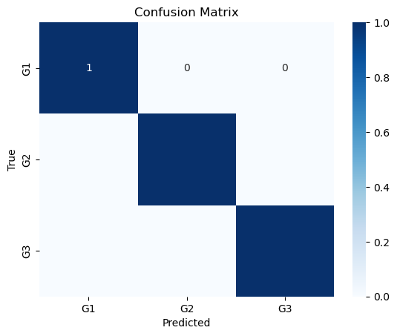
Final Model and Results

Slide 19
Final Model/Results Ctd.
Confusion Matrix:
The confusion matrix shows perfect classification with no misclassifications
Interpretation: The model predicted all instances correctly for each group
precision recall f1-score support
Precision Recall F1-score Support
G1 1.00 1.00 1.00 1
G2 1.00 1.00 1.00 1
G3 1.00 1.00 1.00 1
accuracy 1.00 3
macro avg 1.00 1.00 1.00 3
weighted avg 1.00 1.00 1.00 3

Slide 20
Final Model/Results Ctd.
The Decision Tree model performed exceptionally well with perfect accuracy.
Each intervention group (G1, G2, G3) was accurately classified.
This suggests that the features used (e.g., performance measures T0, T1, T2, and interventions) are strong predictors for categorizing the intervention groups.

Slide 21
Recommendations/Conclusion
Recommendations for Schools:
Nutrition Programs:
Justification: Our analysis indicated a strong correlation between nutrition and student performance. Proper nutrition supports cognitive function, leading to better academic outcomes.
Additional Counseling Services:
Justification: The data showed that students with access to counseling services demonstrated improved emotional well-being and academic performance, especially during the stress of the pandemic.
After-School Programs:
Justification: Engagement in after-school activities was linked to higher levels of student engagement and academic success. These programs provide additional learning opportunities and support.

Slide 22
Recommendations/Conclusion Ctd.
Conclusion:
Study Impact:
Our study highlights the critical role of holistic support systems in enhancing student performance, especially in the context of disruptions like the Covid-19 pandemic.
The recommendations are data-driven and target key areas that can significantly improve student outcomes.
Future Steps:
Further research to expand the dataset and include more diverse variables.
Implementation and evaluation of recommended programs to measure their effectiveness in real-world settings.

